Slide 1
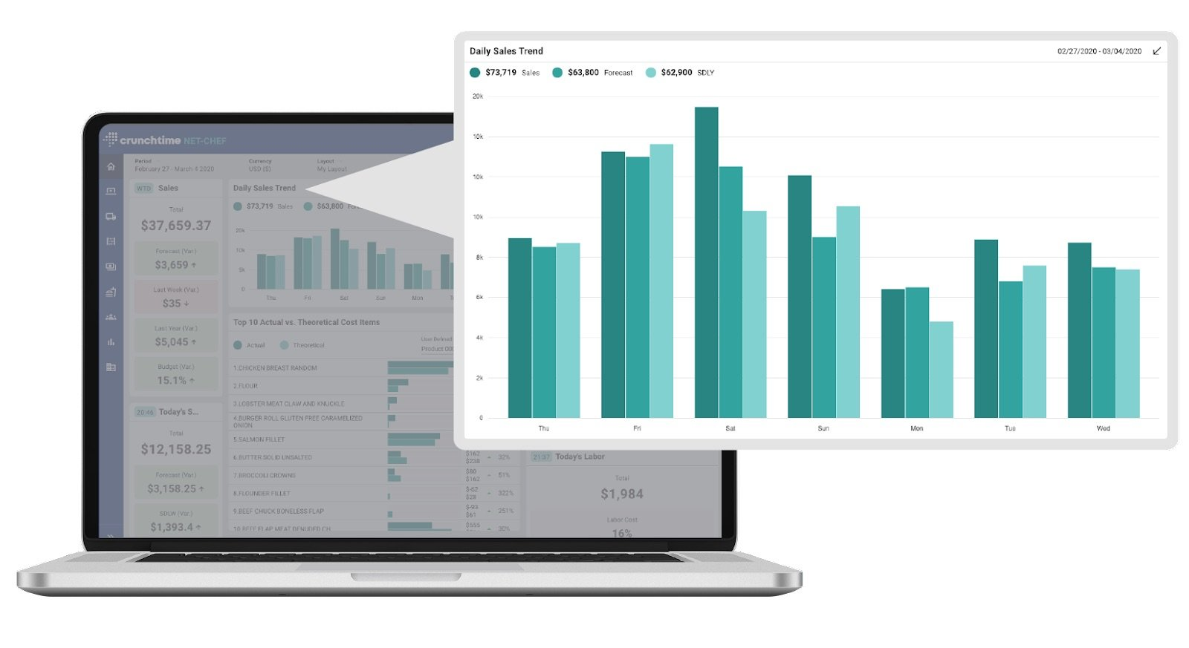
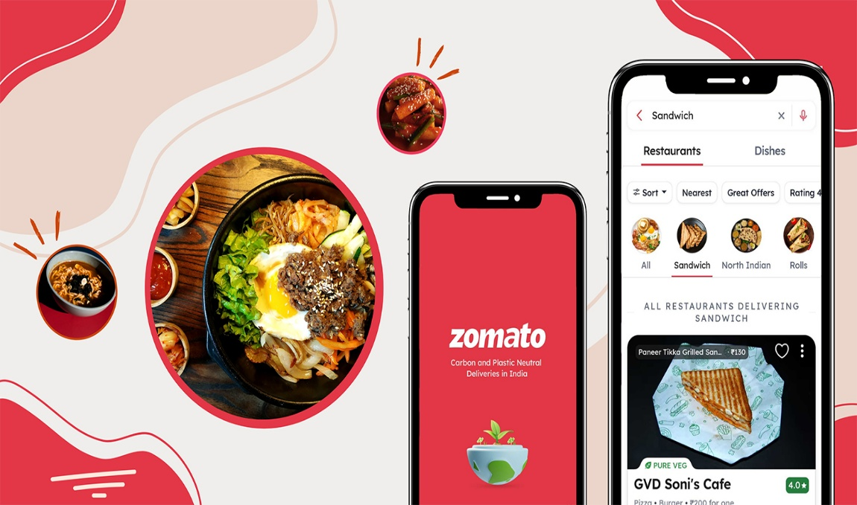
ZOMATO RESTAURANT ANALYSIS
“Data-Driven Insights & Recommendations’’
Mr. CHANANJESHWER .M .P
02/03/2026
Interactive Dashboard (Google Sheets):
https://docs.google.com/spreadsheets/d/1efeRLEHvsvSHCHaZdJ2bsdbmigGfJ0h0/edit?usp=sharing&ouid=106032375274056022459&rtpof=true&sd=true

Slide 2
ABOUT ZOMATO
Introduction:
Did you know that over 65% of restaurant decisions today are influenced by digital platforms like Zomato?
Project Context:
Zomato operates in a highly competitive multi-country market with over 9,500 restaurants in its dataset. While demand is rising, not every city shows equal potential.
Understanding where to expand, which markets are saturated, and which cities show promising customer engagement.
Project Objectives:
Identify high-potential cities for new restaurant openings using data-driven scoring methods.
Analyze market trends in ratings, cost, competition, and customer engagement.
Highlight top opportunities through interactive dashboards, KPIs, and pivot-based insights.

Slide 3
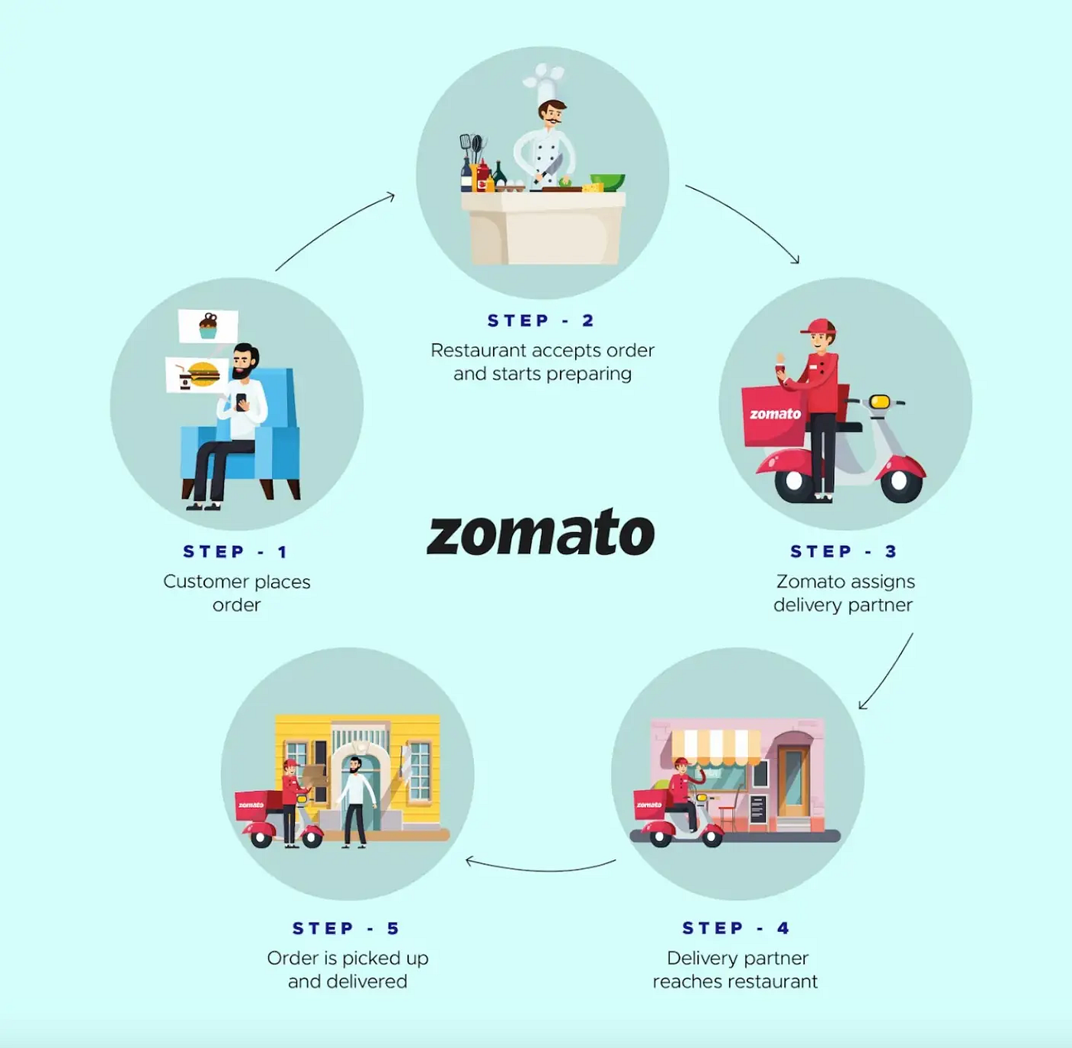
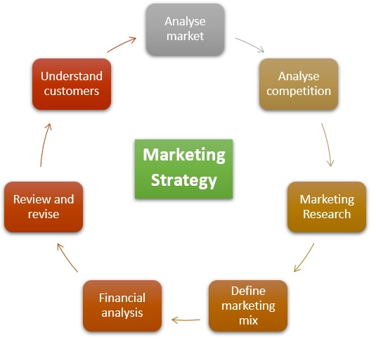
• Analyze Zomato’s restaurant data across multiple countries.
• Identify high-potential countries and cities for new restaurant openings.
• Provide data-backed recommendations on pricing, cuisines, and services.

Slide 4
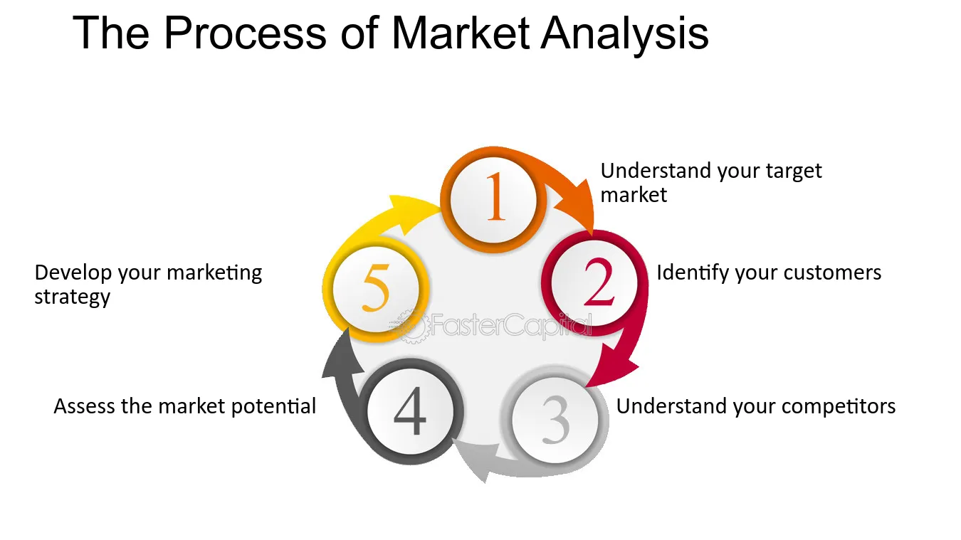
Problem Statement & Business Need
Business Context:
• Zomato operates across multiple countries with diverse restaurant markets.
• Expansion decisions require identifying high-potential, low-competition locations.
Problem:
• Lack of clarity on where to expand, what cuisines to focus on, and how pricing affects demand.
Goal:
• Use data to support smart, low-risk restaurant expansion decisions.

Slide 5
Data Overview
• Total restaurants: 9,551.
• Countries covered: 15.
• Key fields: Country, City, Cuisines, Price Range, Rating, Votes, Online Delivery, Table Booking.
Data Cleaning:
Removed unwanted spaces using TRIM().
Standardized Yes/No columns → TRUE/FALSE.
Corrected inconsistent format and spelling errors using Find and Replace in City column.
Converted Datekey_Opening into proper dates.
Extracted Year from cleaned dates.
Filled blank cuisines with "Unknown".
Normalized currency types.
Mapped Country Codes using VLOOKUP.
Handled inconsistent formats (e.g., text numbers → numeric).

Slide 6
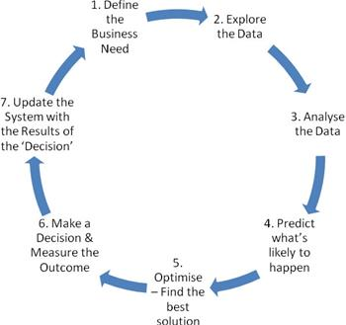
Methodology & Approach
Dataset Summary:
Total Records: 9,551 restaurants across multiple countries.
Key Attributes Used:City, Country Code, Rating, Votes, Average Cost for Two Cuisines, Online Delivery, Table Booking,Price Range,Opening Year.
Data Cleaning & Preprocessing:
Standardized dates (converted YYYY_M_D to valid date format).
Normalized currency and mapped country names using LOOKUP.
Converted boolean-like fields (Yes/No) into TRUE/FALSE for consistency.
Removed or handled missing entries in Cuisines, Cost, and Rating.
Ensured proper data types:
Numeric: Votes, Cost, Price Range.
Categorical: City, Country, Cuisines.
Boolean: Delivery, Booking.
Date: Opening year extracted from DateKey.

Slide 7
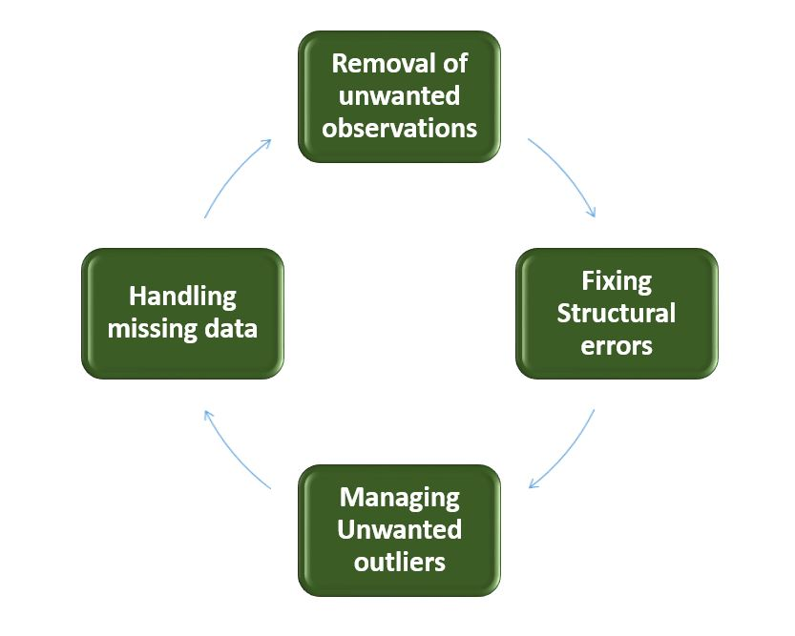
Analytical Approach and Tools
Analytical Approach:
Our analysis followed a structured, step-by-step methodology to ensure accuracy, consistency, and meaningful insights from the Zomato dataset.
Data Cleaning:
• Fixed inconsistent formats (dates, currencies, cuisines).
• Standardized data types (numeric, categorical, boolean, date).
• Added country names using VLOOKUP.
Data Enrichment:
• Extracted Opening Year from DateKey.
• Normalized metrics.
• Final Expansion Score.
Analysis Techniques:
• Applied functions: IF, AVERAGEIF, COUNTIF, AND/OR, IFERROR, IFNA.
• Applied ARRAYFORMULA, UNIQUE, and FILTER for automation.
Visualization:
• Pivot charts.
• Slicers.
• KPI cards.
• Conditional formatting to highlight key cities.

Slide 8
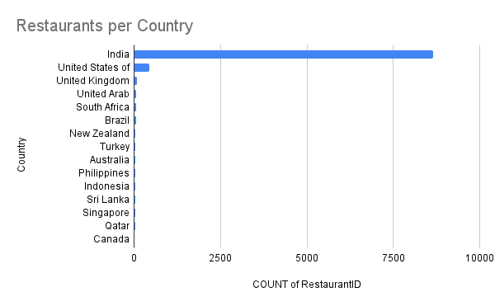
Insights:
• India shows the highest concentration of restaurants, significantly ahead of other countries.
• UAE, Turkey, and Brazil follow with moderate presence.
• Several countries show minimal representation, indicating lower platform penetration or smaller markets.
Takeaway:
The platform’s activity is heavily concentrated in a few key regions, helping us identify markets with strong
demand versus those with lower engagement..

Slide 9
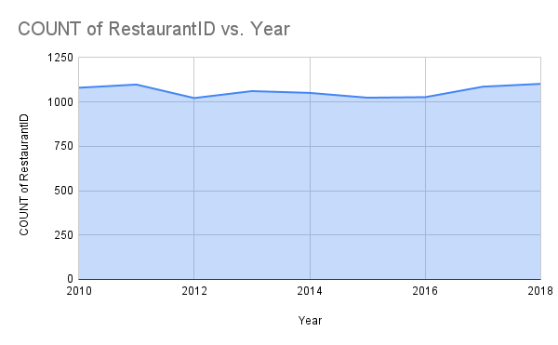
Insights:
• Steady growth in restaurant openings over the years.
• Clear upward trend showing increased adoption of the platform.
• A few years show a spike, indicating rapid expansion phases.
Takeaway:
The year-over-year growth pattern highlights strong market expansion and growing platform relevance for
dining and food delivery businesses.

Slide 10
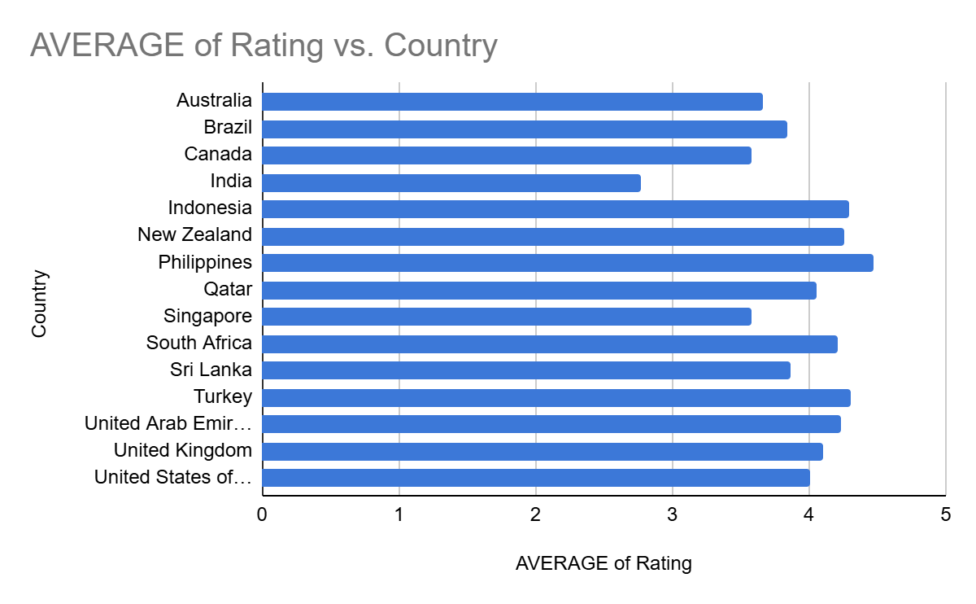
Insights:
Some countries like Philippines, Indonesia , and New Zealand have higher average ratings, showing strong customer satisfaction.
High-restaurant countries such as India have good ratings but also higher competition.
Takeaway:
Higher-rated countries with fewer restaurants offer the best expansion potential, as they combine strong customer experience with lower competitive pressure.

Slide 11
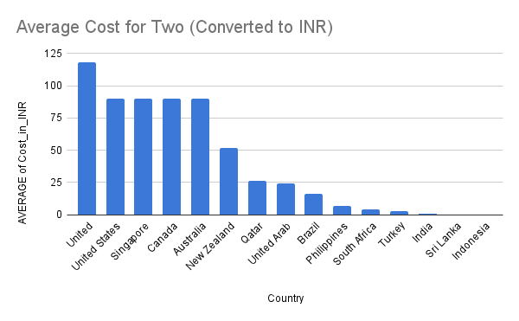
Insights: • Countries like UK, USA, and Singapore show higher average food costs, reflecting higher spending capacity. • Markets such as India and Sri Lanka have lower cost levels, indicating stronger price sensitivity. • There is a clear gap between premium and budget markets, helping identify positioning strategy.
Takeaway: Understanding INR-adjusted costs helps identify where to launch premium outlets (high-cost countries) and where to focus on value pricing (lower-cost markets).

Slide 12
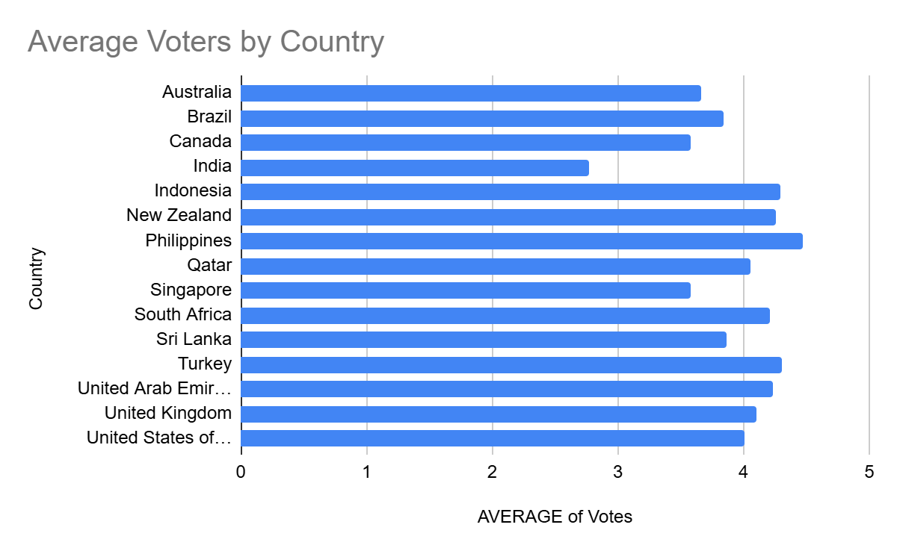
Insights: • Countries like Philippines and New Zealand show higher average voter counts, indicating strong customer
engagement and higher platform usage. • High voter counts generally align with dense, digitally active markets.
Takeaway: Countries with higher voter participation show stronger customer engagement, making them ideal for expansion with strong marketing and digital outreach.

Slide 13
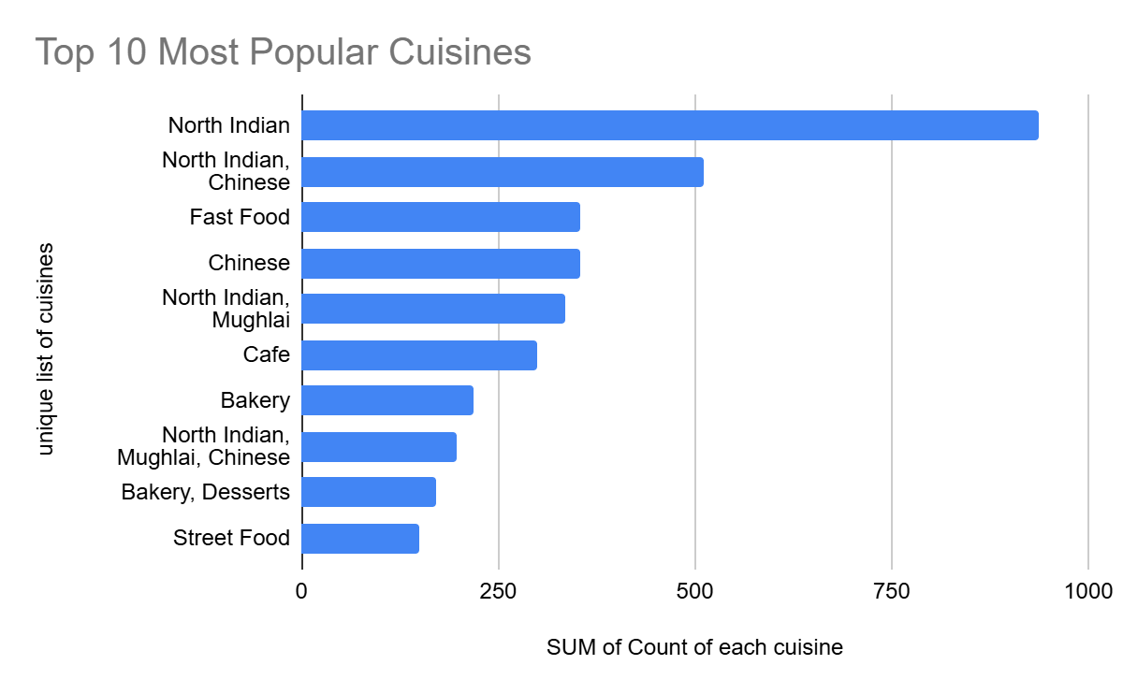
Insights: • North Indian, Chinese, and Fast Food appear most frequently, showing strong and consistent customer
demand. • Popularity also extends to Italian, Bakery, and Continental, reflecting a preference for diverse, multi-cuisine
offerings.
Takeaway: Focusing on the top-performing cuisines increases the chances of customer acceptance in new markets and supports a strong launch strategy for upcoming restaurants.

Slide 14
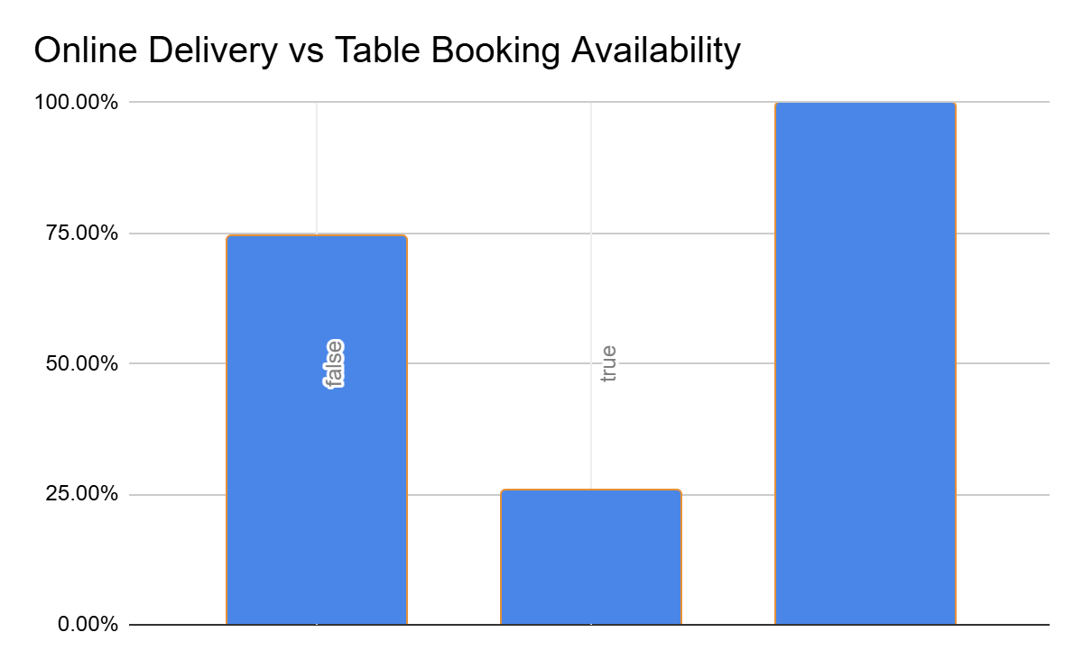
Insights: • Online delivery is far more widely available than table booking across most restaurants. • Table booking is offered only by a smaller share of restaurants, mostly in premium or high-traffic areas.
Takeaway: Online delivery should be a primary focus for expansion, as it aligns with customer preferences and boosts visibility—while table booking can be added selectively for premium or dine-in–heavy regions.

Slide 15
Strategic Recommendation: Market Entry Strategy
Recommendation:
• Adopt a Tiered Expansion Approach:
• Tier 1 (Immediate Expansion): Cities with strong ratings + affordable costs Colombo, Doha, Jakarta.
• Tier 2 (Secondary Expansion): High potential but premium-priced markets Auckland, Wellington.
Why This Strategy Works:
• Reduces financial risk by entering proven markets first.
• Allows brand to establish a footprint before entering premium regions.
• Ensures sequential rollout based on real performance.
Expected Impact:
• Faster break-even in Tier 1 markets.
• Strong brand presence before entering Tier 2 markets.
• Better long-term regional diversification.

Slide 16
Dashboard & Key Visualizations
• The dashboard consolidates restaurant distribution, customer preferences, rating patterns, and market
scoring in a single view.
• Year-wise slicer helps identify growth trends and seasonality in openings.
• Scorecards highlight quick metrics such as Total Restaurants, Avg Rating, Avg Cost, Online Delivery %.
️ Key Interactive Features:
• Slicers/Filters:
• Year
• Country
• Price Range
• Online Delivery
• These slicers dynamically update charts and KPIs to support faster decision-making.
Why This Dashboard Matters:
• Makes complex data easy to digest at a glance.
• Helps leadership quickly identify.
• Expansion-ready markets.
• High-performance cuisines.

Slide 17
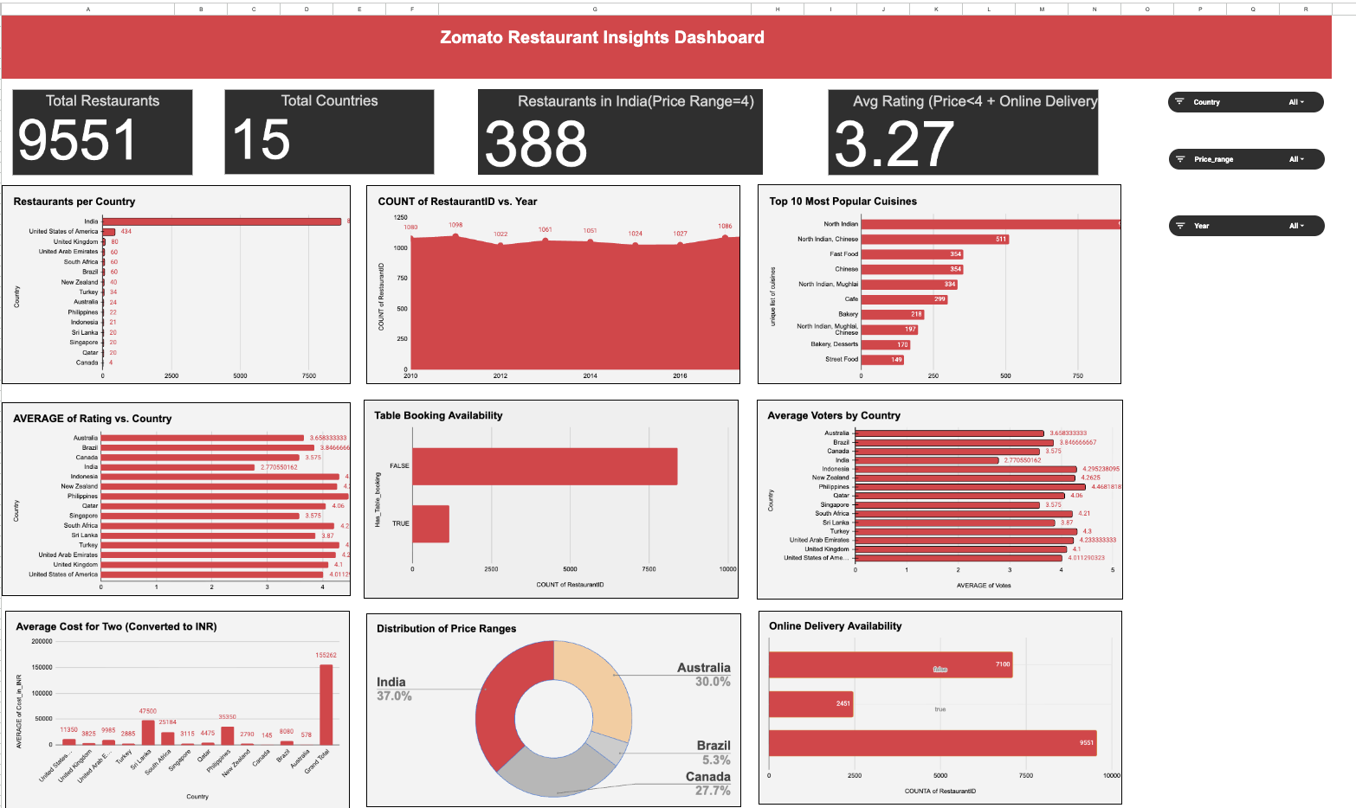
Interactive Dashboard (Google Sheets): https://docs.google.com/spreadsheets/d/1efeRLEHvsvSHCHaZdJ2bsdbmigGfJ0h0/edit?usp=sharing&ouid=106032375274056022459&rtpof=true&sd=true

Slide 18
Conclusion
Key Takeaways:
• The data reveals clear opportunities in countries with low restaurant density and strong customer engagement.
• Cities like Colombo, Doha, Jakarta, Auckland, and Wellington emerge as the most promising for expansion
based on ratings,cost structure, and competition level.
• Customer preferences strongly favor mid-range pricing, popular cuisines such as Fast Food, Indian,Continental,
and restaurants offering online delivery.
Implications for Business:
• Entering the identified markets gives the company a competitive first-mover advantage.
• A structured expansion roadmap ensures scalable growth across multiple geographies.
Final Statement:
This analysis empowers the organization with clear, data-backed insights to make confident expansion decisions.
By combining market potential, customer behavior, and operational factors, we have identified a strategic path
for long-term, sustainable growth.

Slide 19
Acknowledgements & References
Acknowledgements:
• I extend my sincere thanks to the training faculty and mentors for their continuous support, guidance, and
domain insights throughout this project.
• Special appreciation to the data analytics program team, whose structured learning modules enabled the
completion of this end-to-end analysis.
• Gratitude to all peers and collaborators who contributed with feedback, suggestions, and knowledge-
sharing during the execution of this project.
References:
• Dataset source: Zomato Restaurant Dataset (Provided by Newton School / Course Material)
• Visualization techniques and design inspiration:
• Function documentation and best practices:
• Google Sheets Function Reference — https://support.google.com/docs/
• Online restaurant and food delivery trend reports (Statista & Public Market Reports).
Interactive Dashboard (Google Sheets):
https://docs.google.com/spreadsheets/d/1efeRLEHvsvSHCHaZdJ2bsdbmigGfJ0h0/edit?usp=sharing&ouid=106032375274056022459&rtpof=true&sd=true

Slide 20


